Slide 1
Design and Analysis of Algorithms
CS602
Lecture 9
Stable Matching Algorithm
Final lecture on Joint Seat Allocation

Slide 2



Dijkstra’s algorithm
Dijkstra-algo($s$,$G$)
$U$ ← $V$;
$L\left(s\right)$← $0$;
For $i$ = 0 to $n−1$ do
{ $y$← vertex from $U$ with minimum value of $L$;
$δ\left(s,y\right)\text{←}L\left(y\right)$;
move $y$ from $U$ to $S$;
For each $(y,v)∈E$ with $v∈U$do
{
$L\left(v\right) \text{←}$ min( $L\left(v\right)$, $δ\left(s,y\right)+ω\left(y,v\right)$ )
}
}
$L\left(v\right)$← $∞$ for all $v∈U$ ;
1 extract-min operation
deg($y$) Decrease-key operations
Maintain a Min-Heap on $L$.

Slide 3
The Stable Marriage Problem

Slide 4
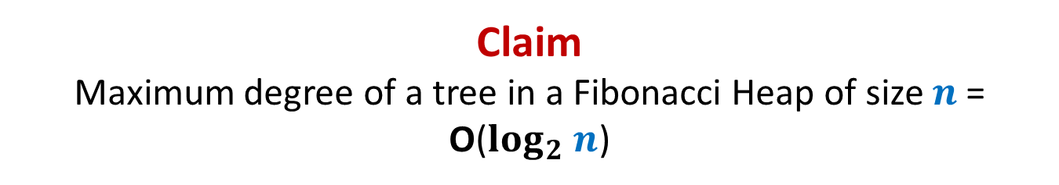












Stable Marriage Problem
Women
Men
$$w_{1}$$
$$m_{1}$$
$$3$$
…
$$w_{2}$$
$$m_{2}$$
$$1$$
…..
$$w_{3}$$
$$m_{3}$$
$$2$$
$$w_{i}$$
$$m_{j}$$
$$w_{n}$$
$$m_{n}$$

Slide 5




Stable Marriage Problem
Women
Men
$$w_{1}$$
$$m_{1}$$
$$3$$
$$w_{2}$$
$$m_{2}$$
…
…
$$1$$
$$w_{3}$$
$$m_{3}$$
…..
$$2$$
$$k$$
$$w_{i}$$
$$m_{j}$$
$$w_{n}$$
$$m_{n}$$

Slide 6
Stable Marriage Problem
Women
Men
Marriage : ?
$$w_{1}$$
$$m_{1}$$
$$w_{2}$$
$$m_{2}$$
$$w_{3}$$
$$m_{3}$$
…
…
$$w_{i}$$
$$m_{j}$$
…
…
$$w_{n}$$
$$m_{n}$$
a bijection between Women and Men

Slide 7




Stable Marriage Problem
Meaning of unstability
$w_{l}$ prefers $m_{j}$ to $m_{k}$
$m_{j}$ prefers $w_{l}$ to $w_{i}$
Definition:
A marriage is said to be stable if there is no unstable pair in the society.
($w_{l}$, $m_{j}$) : an unstable pair
$$w_{l}$$
divorce
$$m_{k}$$
$$w_{i}$$
divorce
$$m_{j}$$

Slide 8

Stable Marriage Problem
$M$ : set of $n$men
$W$ : set of $n$women
For each man $m∈M$,
$L(m)$: a preference list of all women
For each woman $w∈W$,
$L(w)$: a preference list of all men
Aim: To compute a stable marriage.

Slide 9
Algorithm for Stable Marriage
1962, David Gale and Lloyd Shapley
Nobel Prize in Economic Sciences, 2012
Man proposes, God disposes
Woman

Slide 10



Man proposes, Woman disposes
Women
Men
$$w_{1}$$
$$m_{1}$$
$$2$$
$$w_{2}$$
$$m_{2}$$
$$1$$
$$w_{3}$$
$$m_{3}$$
$$1$$
$$1$$
$$w_{i}$$
$$m_{j}$$
$$w_{n}$$
$$m_{n}$$

Slide 11
Design the algorithm now …
Rule for Men
A man proposes in the decreasing order of preference.
Once rejected by a woman, the man never proposes to her again.
A woman, if single, accepts a proposal.
A woman, if engaged, accepts a proposal from a man if she prefers him to her current partner.
Rule for Women

Slide 12
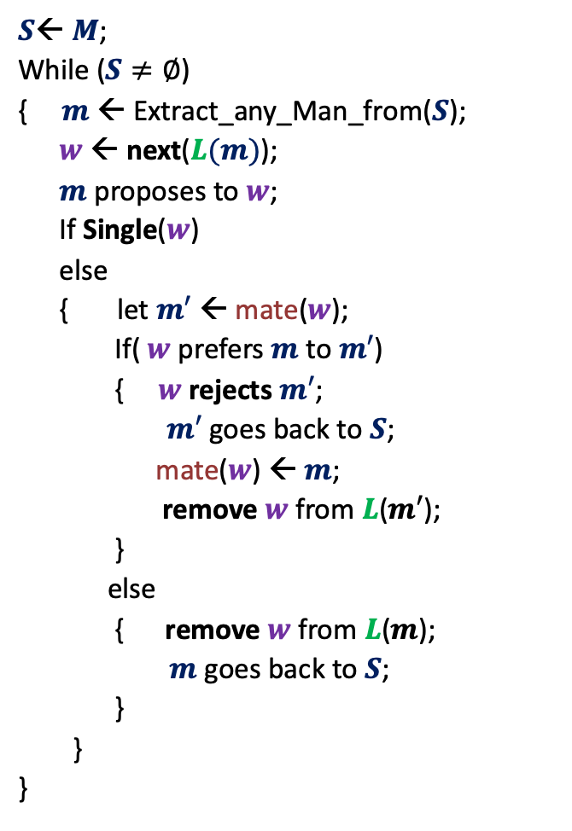



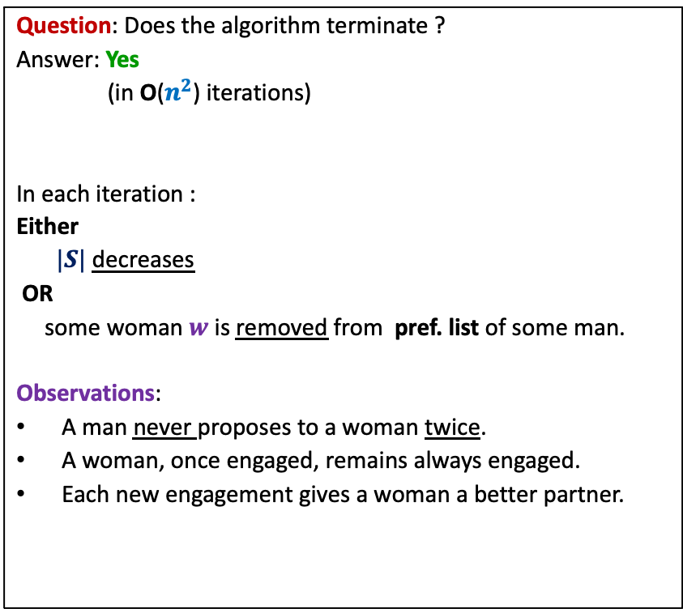
GaleShapley($M$, $W$)
$S$← $M$;
While ($S≠∅$)
{ $m$← Extract_any_Man_from($S$);
$w$ ← next($L(m)$);
$m$ proposes to $w$;
If Single($w$)
else
{ let $m′$ ← mate($w$);
If( $w$ prefers $m$ to $m′$)
{ $w$rejects $m′$;
$m′$ goes back to $S$;
mate($w$) ← $m$;
remove $w$from $L$($m′$);
}
else
{ remove $w$from $L$($m$);
$m$ goes back to $S$;
}
}
}
Question: Does the algorithm terminate ?
Answer: Yes
(in O($n^{2}$) iterations)
In each iteration :
Either
$|S|$ decreases
OR
some woman $w$is removed from pref. list of some man.
Observations:
A man never proposes to a woman twice.
A woman, once engaged, remains always engaged.
Each new engagement gives a woman a better partner.
mate($w$) ← $m$;
Any measure of progress ?
in list $L(w)$, $m$precedes $m′$)

Slide 13


GaleShapley($M$, $W$) (Proof of stability)
There is no unstable pair in the marriage.
How to restate it so that we can prove it easily ?
Lemma :
If $m_{j}$ prefers $w_{l}$ to $w_{i}$
➔ $w_{l}$ prefers $m_{k}$ to $m_{j}$.
$$w_{l}$$
$$m_{k}$$
$$w_{i}$$
$$m_{j}$$
The key observation :
Each new engagement gives a woman a better partner (mate).

Slide 14
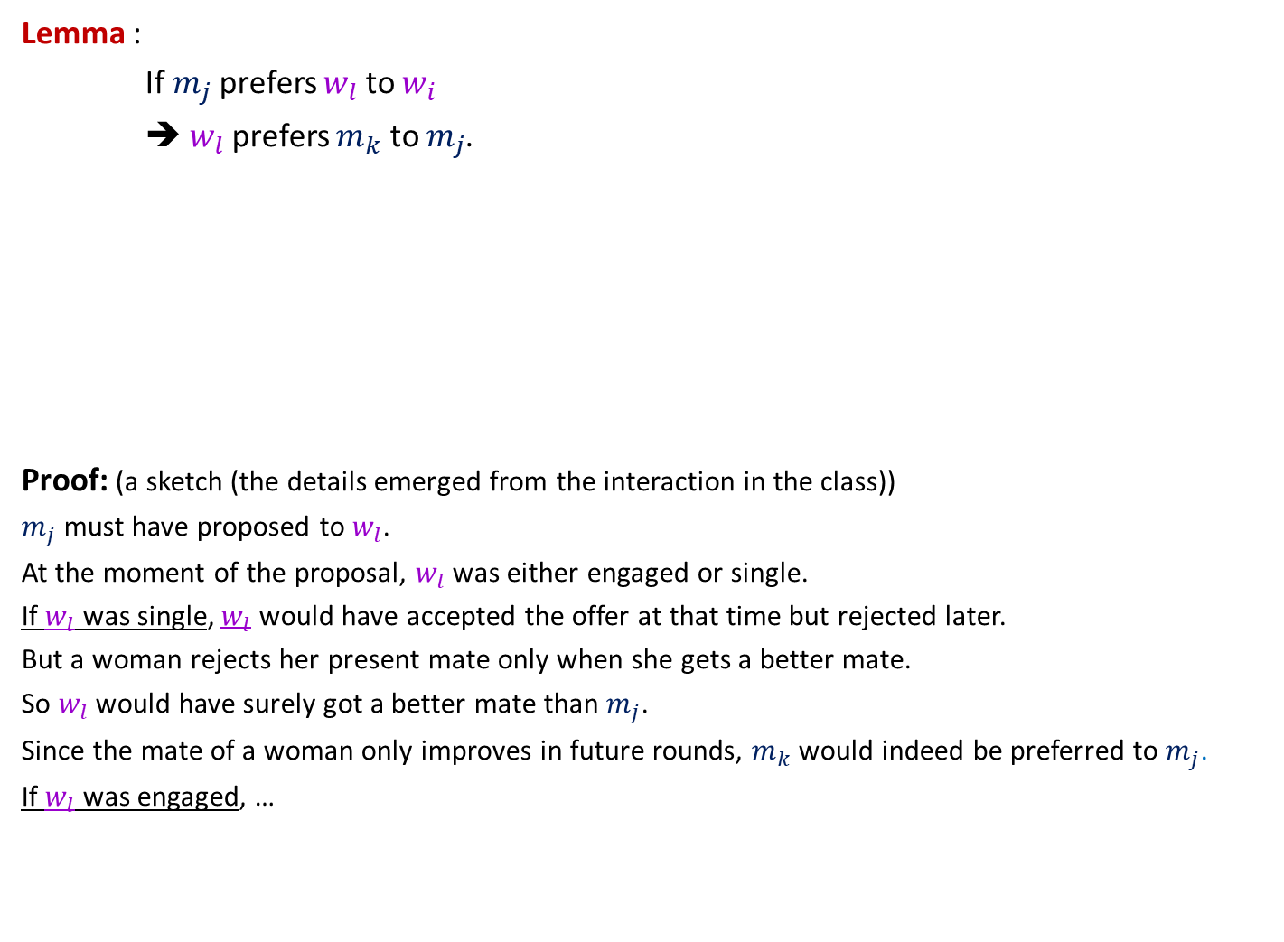
GaleShapley($M$, $W$) (Proof of stability)
Lemma :
If $m_{j}$ prefers $w_{l}$ to $w_{i}$
➔ $w_{l}$ prefers $m_{k}$ to $m_{j}$.
Proof: (a sketch (the details emerged from the interaction in the class))
$m_{j}$ must have proposed to $w_{l}$.
At the moment of the proposal, $w_{l}$ was either engaged or single.
If $w_{l}$ was single, $w_{l}$ would have accepted the offer at that time but rejected later.
But a woman rejects her present mate only when she gets a better mate.
So $w_{l}$ would have surely got a better mate than $m_{j}$.
Since the mate of a woman only improves in future rounds, $m_{k}$would indeed be preferred to $m_{j}$.
If $w_{l}$ was engaged, …
$$w_{l}$$
$$m_{k}$$
$$w_{i}$$
$$m_{j}$$

Slide 15
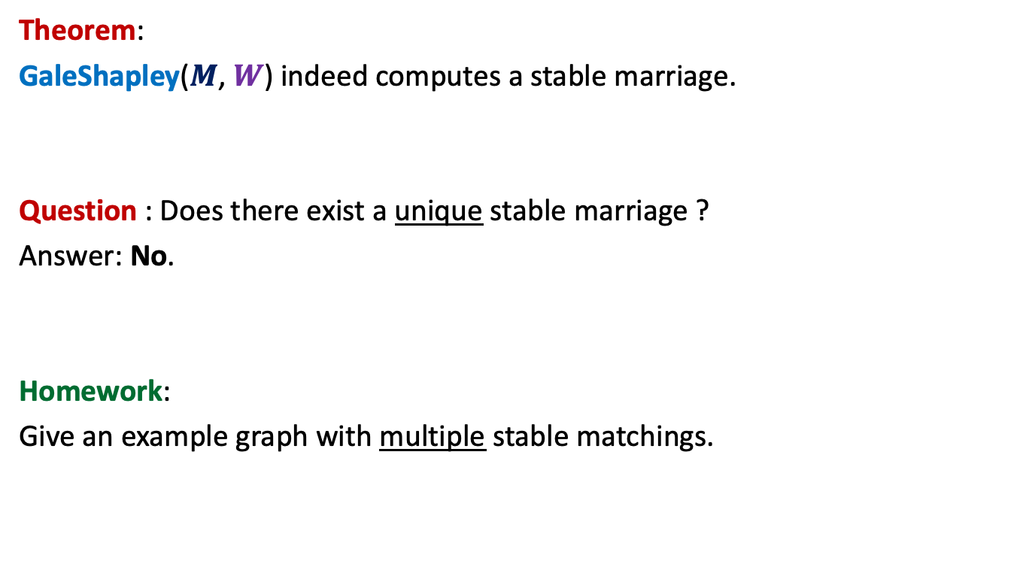
GaleShapley($M$, $W$)
Theorem:
GaleShapley($M$, $W$) indeed computes a stable marriage.
Question : Does there exist a unique stable marriage ?
Answer: No.
Homework:
Give an example graph with multiple stable matchings.

Slide 16


Gale Shapley Algorithm
Theorem:
There cannot exist any other stable matching
that matches a man to a better woman.
Man proposing
Woman pessimal
Man Optimal

Slide 17
Gale Shapley Algorithm
Woman proposing
Woman Optimal
Man Pessimal
Homework: Strive to design a neat, simple, and intuitive proof for the theorem
The proof is not part of the syllabus for Quiz 2. So feel relaxed ☺

Slide 18
Real challenge of multiple merit lists

Slide 19

Multiple merit lists
 | $$1$$ | $$2$$ | $$3$$
IIT
NIT
ARCH
 | $$1$$ | $$2$$ | $$3$$
A
B
C
C B A
IIT
ARCH
NIT
A C B
NIT
IIT
ARCH
B A C
ARCH
NIT
IIT
Merit Lists
Choice Lists
A
B
C
Allocation $1$
Allocation $2$
Allocation $3$
IIT
NIT
ARCH
IIT
NIT
ARCH
IIT
NIT
ARCH
C
A
B
A
B
C
B
C
A
Candidate Pessimal
Candidate Optimal

Slide 20






Gale Shapley Algorithm
Women
Men
$$w_{1}$$
$$m_{1}$$
$$w_{2}$$
$$m_{2}$$
$$w_{3}$$
$$m_{3}$$
$$w_{i}$$
$$m_{j}$$
$$w_{n}$$
$$m_{n}$$

Slide 21







Gale Shapley Algorithm
Programs
Men
$$P_{1}$$
$$m_{1}$$
$$P_{2}$$
$$m_{2}$$
$$P_{3}$$
$$m_{3}$$
$$P_{i}$$
$$m_{j}$$
$$P_{n}$$
$$m_{n}$$

Slide 22





Gale Shapley Algorithm
Deferred Acceptance Algorithm
Programs
Candidates
$$P_{1}$$
$$c_{1}$$
$$P_{2}$$
$$c_{2}$$
Preference lists
Unstability
$$P_{3}$$
$$c_{3}$$
Unfairness
Merit lists
$$P_{i}$$
$$c_{j}$$
$$P_{n}$$
$$c_{m}$$

Slide 23
Deferred Acceptance Algorithm
Programs
Candidates
$$P_{1}$$
$$c_{1}$$
$$P_{2}$$
$$c_{2}$$
$$P_{3}$$
$$c_{3}$$
$$P_{i}$$
$$c_{j}$$
$$P_{n}$$
$$c_{m}$$

Slide 24

$3$Algorithms
Gale Shapley
algorithm
Limited rounds
Programme proposing
Programme proposing
Candidate proposing
Common man’s algorithm
Software Industry’s algorithm
Deferred Acceptance algorithm
Candidate Pessimal
Candidate Pessimal
Candidate Optimal

Slide 25
Merits of Deferred Acceptance Algorithm
Any number of merit lists
Candidate optimality guaranteed
Efficient Algorithm
Joint Seat Allocation
Deferred Acceptance Algorithm

Slide 26
Business rules of admissions
Affirmative action rules
Freeze/Float/Slide/withdraw
Supernumerary Seats for Female Candidates [’18 - ]
No increase in male seats
No adverse affect on chances for the male candidates
Create supernumerary seats (not reservation at all !)

Slide 27

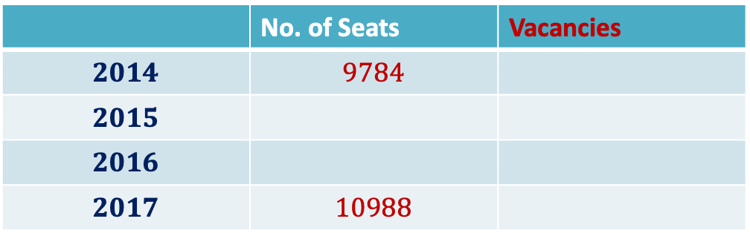



Impact of Joint Seat Allocation
Vacancies in IITs
 | No. of Seats | Vacancies
$$2014$$ | $$9784$$
$$2015$$
$$2016$$
$$2017$$ | $$10988$$
$$587$$
$$308$$
$$190$$
$$198$$

Slide 28

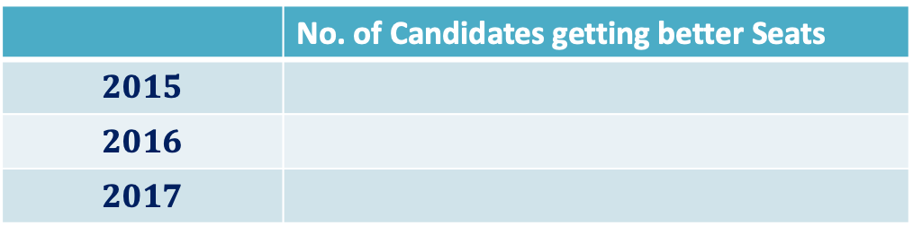



Impact of Joint Seat Allocation
 | No. of Candidates getting better Seats
$$2015$$
$$2016$$
$$2017$$
$$1890$$
$$1767$$
$$1↔300$$
$$3672$$

Slide 29
Algorithms do have great impact in real world …

Slide 30
Impact of Joint Seat Allocation
INFORMS J. Appl. Anal., 49(5) 338-354 (2019)
The above research paper is available on the homepage of the instructor.
Read it to see the role of algorithms in your journey to IITK ☺
Not meant for exam or quizzes ☺
Centralized Admissions for Engineering Colleges in India
S. Baswana, P. P. Chakrabarti, S. Chandran, Y. Kanoria, U. Patange

